Slide 1

ALGORITHMIC TRADING
MAJOR PROJECT PHASE-I
BATCH NO. 62
L Bharadwaj 18H51A0517
M M Prathyush 18H51A0518
G Vineetkumar 18H51A0596
USING MACHINE LEARNING

Slide 2
PROBLEM UNDERSTANDING
MOTIVATION OF STUDY
OBJECTIVES
PROBLEM STATEMENT, SCOPE & LIMITATIONS

Slide 3
MOTIVATION OF STUDY
Now a day’s, the prediction of stock market prices has become a major research topic
The behavior of stock market is very nonlinear and volatile in nature.
So Investing has become a risky task for the people.
But it is not at all a risky task to machine that uses machine learning techniques.
Infact the predictions will be very close to real time data

Slide 4

OBJECTIVE
Our objective is to predict stock market that is very close to real time
Implement existing methods and compare them

Slide 5

PROBLEM STATEMENT
Stock market is just like a probabilistic trading where we can gain and have possibility of loss. Investing in stock market trading might be a risky task. So, we can use algorithmic trading which uses the previous trends of a particular stock and help us predicting investing in the stock that gives us more profit.

Slide 6

SCOPE & LIMITATIONS
We predict the stock market upto one month.
It is hard to predict in the pandemic sitations

Slide 7
DATA SET COLLECTION
NSE (National Stock Exchange of India)
BSE (Bombay Stock Exchange)
NYSE (New York Stock Exchange)
Money Control
Google Stock Prices
Yahoo
China’s Shanghai and Shenzhen stock markets

Slide 8
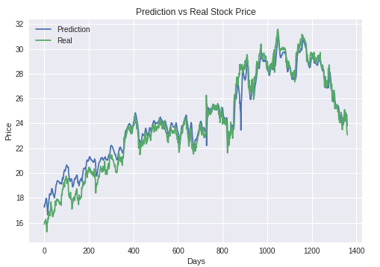
IMPLEMENTATION OF EXISTING METHODS
Predicting Stock Price with LSTM
We choosen it because its prediction is very close to real values.
It is widely used for sequence prediction and have proven to be extremely effective.
LSTM can store past important information and forget the useless information.
FIG: SAMPLE RESULT

Slide 9
PROCESS
Loading the Data
Train and Test Split
LSTM
Prediction
Results
Conclusion

Slide 10
THANK YOU
ALL
OUR GUIDE
TEAM

